Slide 1

Plan B: Just tune it!
Bayesian Optimisation for Hyperparameter Tuning
Using the same kernel: https://www.kaggle.com/gaborfodor/from-eda-to-the-top-lb-0-367
Python Package:
‘pip install bayesianoptomization’
refer: https://github.com/fmfn/BayesianOptimization/blob/master/README.md
https://www.kaggle.com/omarito/xgboost-bayesianoptimization
Paper: ‘Practical Bayesian Optomization of Machine Learning Algorithms’
Bayesian Optimization information on YouTube:
Machine learning - Introduction to Gaussian processes – Nando de Freitas
Machine learning - Gaussian processes – Nando de Freitas
Machine learning - Bayesian optimization and multi-armed bandits– Nando de Freitas

Slide 2
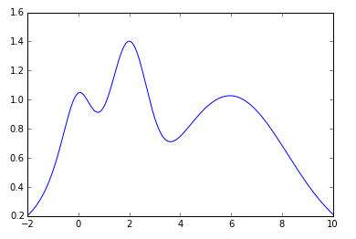
Plan B: Just tune it! - Bayesian Optimisation for Hyperparameter Tuning (continued)
Finding the parameters that give us the best score
Grid Search
Random Search
f(x)
f(x)
x
x
Have to run several times and gradually, manually attempt to zero-in on likely area.
We take the parameters of the highest scoring observation, which might not be optimum.

Slide 3
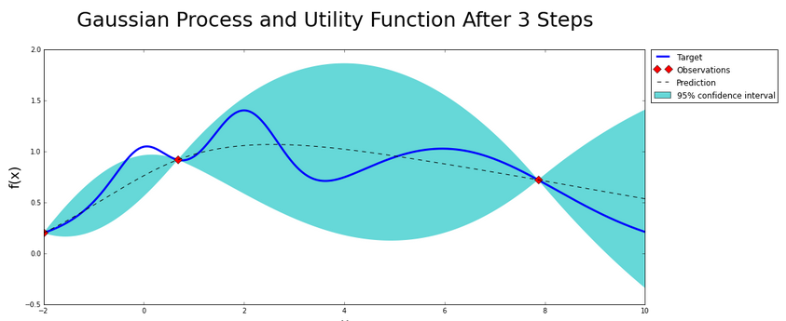
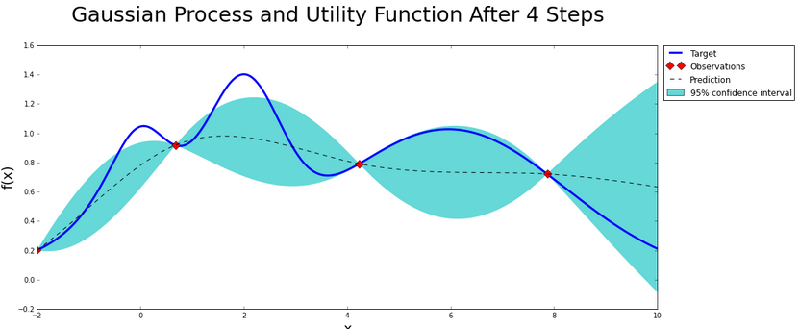
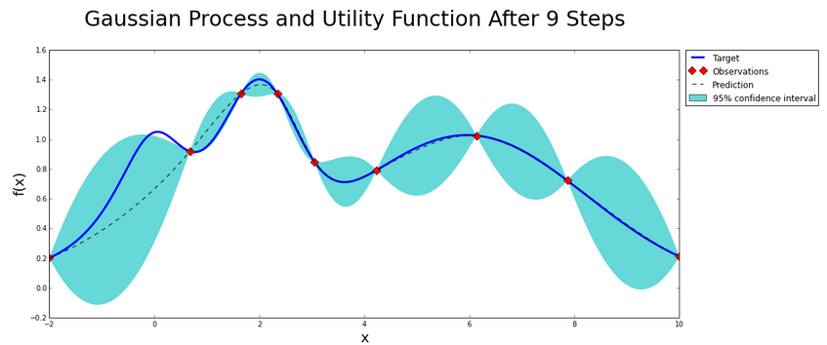
Plan B: Just tune it! - Bayesian Optimisation for Hyperparameter Tuning (continued)
Behold ‘Bayesian Optomization for Hyperparameter Tuning’
Uses all previous observations to construct a probabilistic model for f(x) and calculates where in x to next evaluate.
(Doesn’t rely on the local gradient, hessian approx., etc.)
Next observation
Finds global maximum

Slide 4
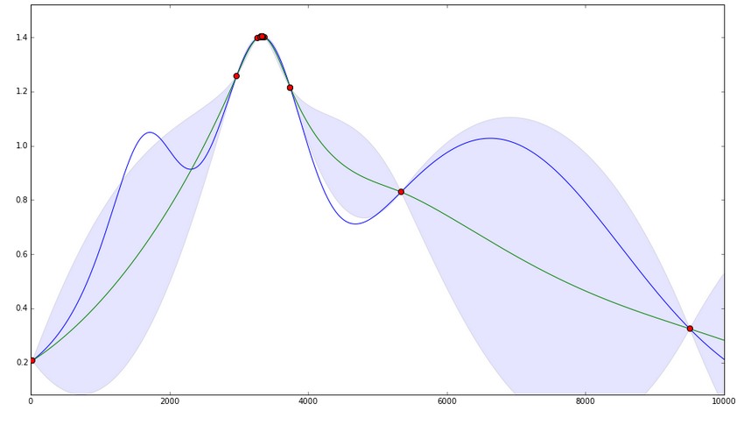
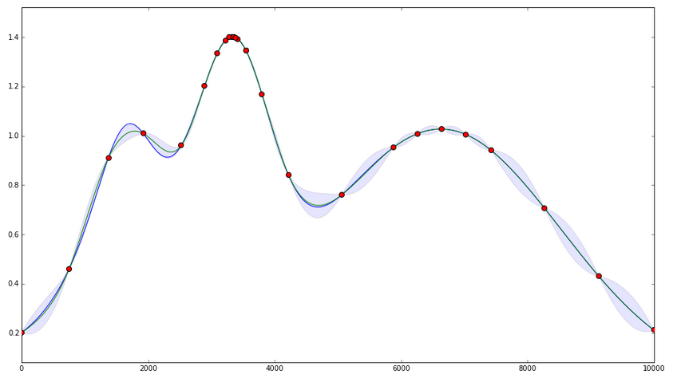
Plan B: Just tune it! - Bayesian Optimisation for Hyperparameter Tuning (continued)
Exploitation versus Exploration
< Exploitation-----------------------Exploration >
Points are around the peaks
Points are spread-out across the range
Acquisition Functions:
- Upper Confidence Bounds
- Expected Improvement
- Probability of Improvement

Slide 5
Plan B: Just tune it! - Bayesian Optimisation for Hyperparameter Tuning (continued)
What does this look like in code?
params = {'max_depth’: (2, 20),
'min_child_weight’:(1, 120)}
# Build BO object
xgb_bayesopt = BayesianOptomization(FunctionToOpt, params)
# Run BO
xgb_bayesopt.maximize(init_points=4, n_iter=200, acq="ucb", kappa=10)
print('Best Score='xgb_bayesopt.res['max']['max_val']
print('Best Params= ', xgb_bayesopt.res['max']['max_params'])
def FunctionToOpt(param1, param2):
set default xgb parameters
xgb.cv(…. cross validation
return score

Slide 6
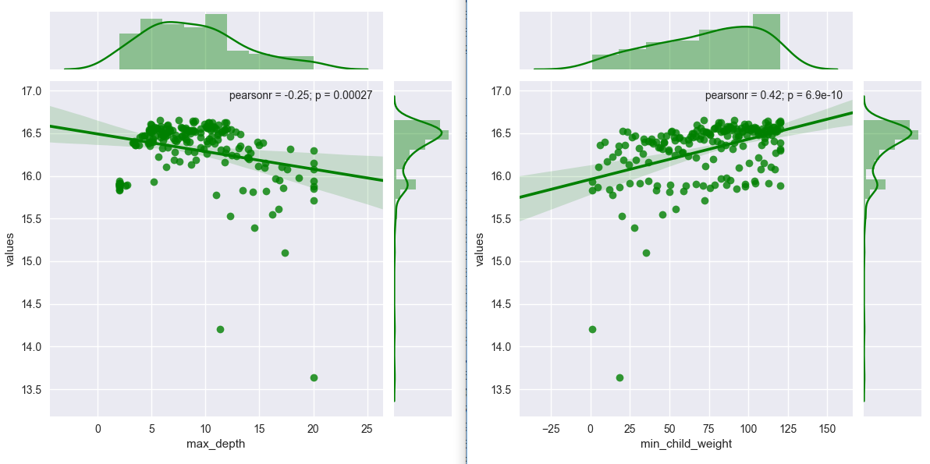
Plan B: Just tune it! - Bayesian Optimisation for Hyperparameter Tuning (continued)
Phase 1: Initial Tune for ‘Tree Complexity’
xgb_bayesopt.maximize(init_points=4, n_iter=200, acq="ucb", kappa=10)
Max_depth (2, 20)
Mcw (0, 120)
Seems to be working!

Slide 7
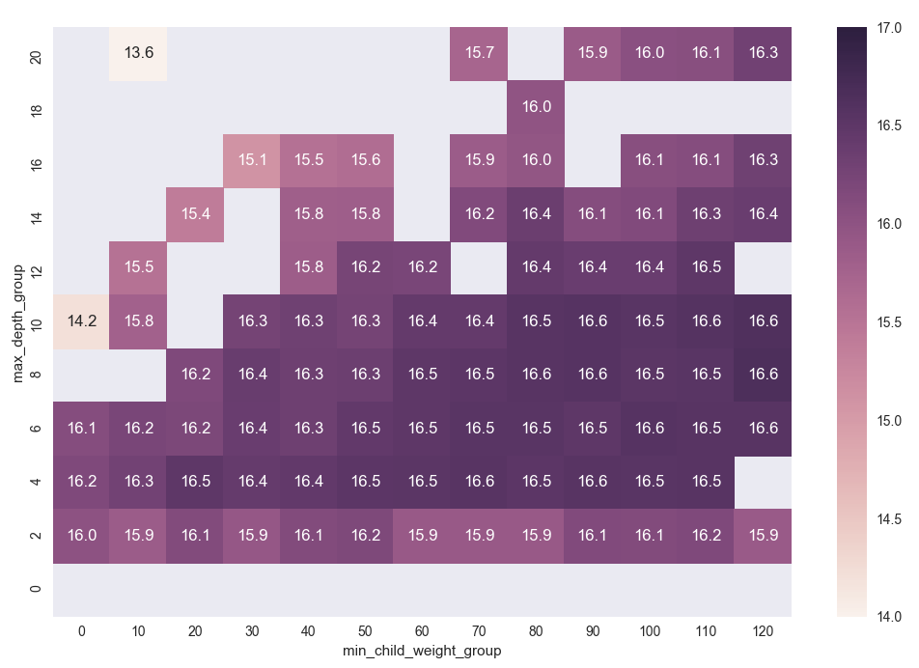
Plan B: Just tune it! - Bayesian Optimisation for Hyperparameter Tuning (continued)
The same data on a heatmap

Slide 8
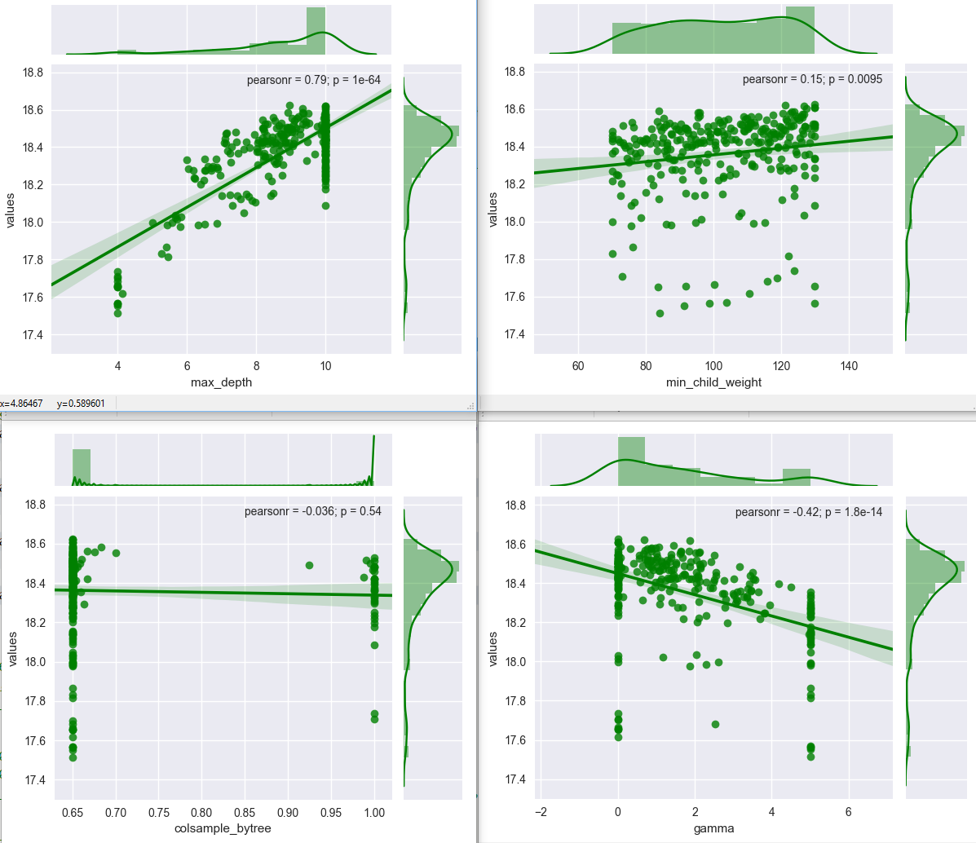
Plan B: Just tune it! - Bayesian Optimisation for Hyperparameter Tuning (continued)
Phase 2: Refined
Max_depth (4, 10)
Mcw (70, 130)
Colsample (0.65, 1)
Gamma (0, 5)
xgb_bayesopt.maximize(init_points=10, n_iter=250, acq="ucb", kappa=10)
xgb_bayesopt.maximize(n_iter=50, acq="ucb", kappa=5) - more exploitation

Slide 9
Plan B: Just tune it! - Bayesian Optimisation for Hyperparameter Tuning (continued)
Final score
 | Kernel | BO Tuning
max_depth | 10 | 9 (8.96096)
min_child_weight | 50 | 130
colsample_bytree | 0.3 | 0.65
subsample | 0.8 | 1
gamma | 0 | 0
lambda | 1 | 0
eta | 0.3 | 0.3
After increasing number boost rounds to 200 and lambda=1: .38379 - up 21 places to 188^{th.}
Public LB Score:
.38948 221st
.38555 - up 12 places to 209th
Thoughts:
It works! A good tool to have in your ML toolbox.
It might not work for every algo, or might take a very long time – your ML function might not have a clear global maximum.
Might want to use Grid and Random search for fine tuning.

Slide 10
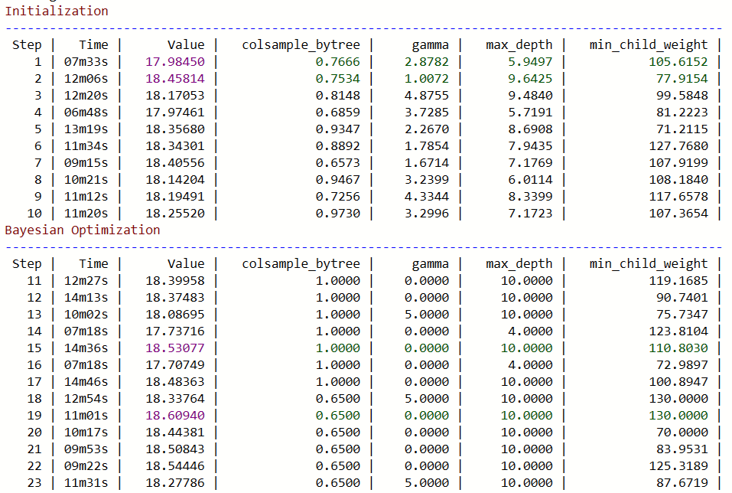
Plan B: Just tune it! - Bayesian Optimisation for Hyperparameter Tuning (continued)
Output – 1 of 3

Slide 11
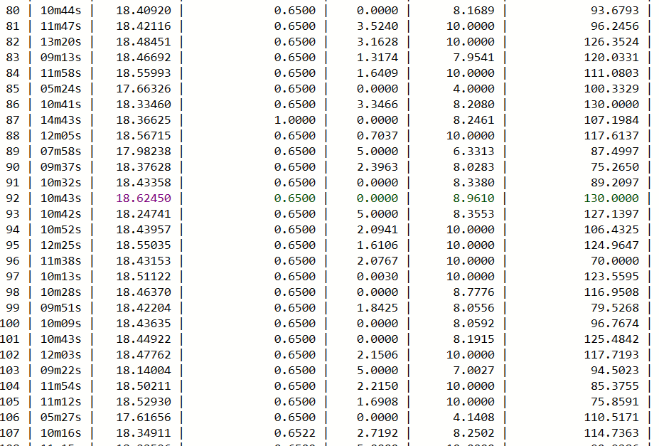
Plan B: Just tune it! - Bayesian Optimisation for Hyperparameter Tuning (continued)
Output – 2 of 3

Slide 12
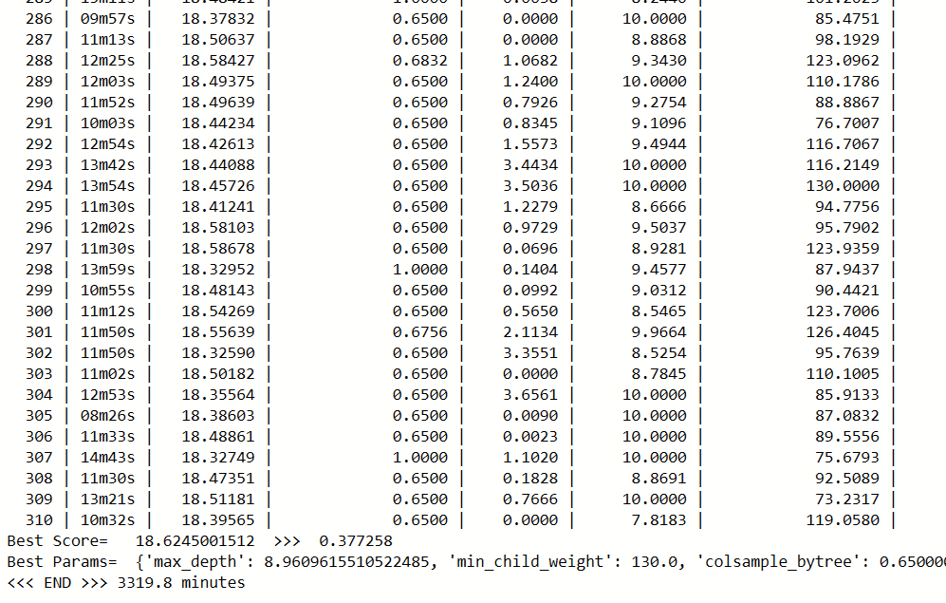
Plan B: Just tune it! - Bayesian Optimisation for Hyperparameter Tuning (continued)
Output – 3 of 3

